Slide 1
Unit 2

Slide 2
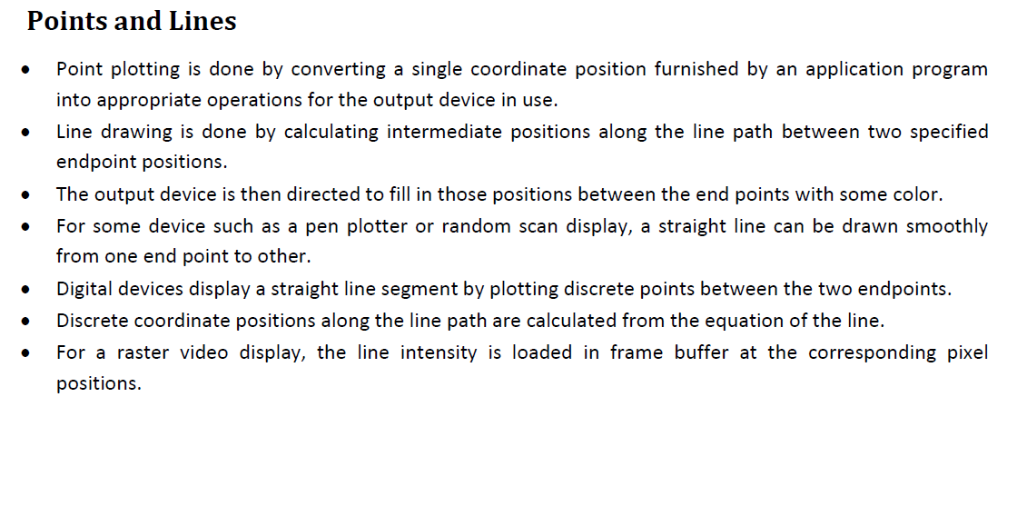

Slide 3
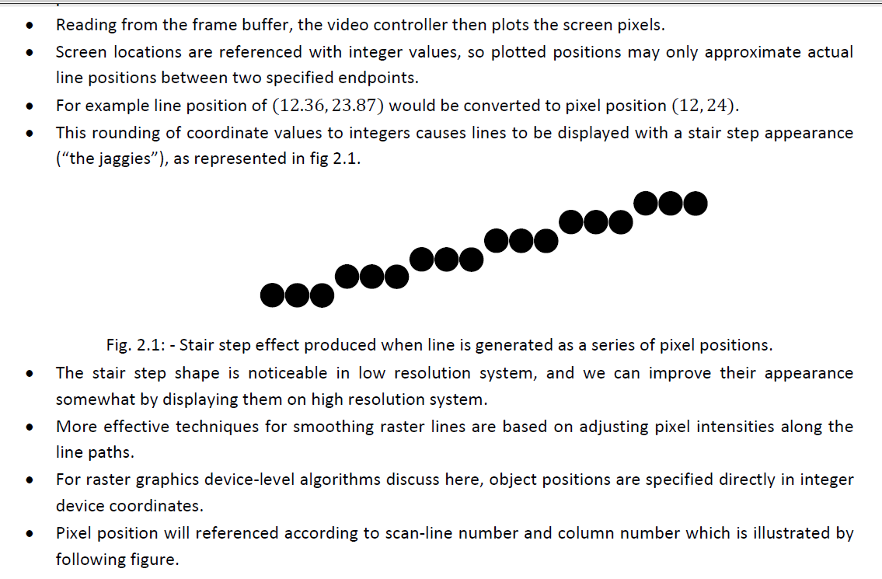

Slide 4
Line Drawing Algorithms
A line in Computer graphics is a portion of straight line that extends indefinitely in opposite direction.
It is defined by its two end points.
Its density should be independent of line length.
the slope intercept equation for a line:
y = mx + b (1)
where, m = Slope of the line
b = the y intercept of a line

Slide 5
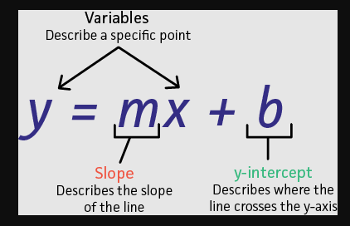

Slide 6
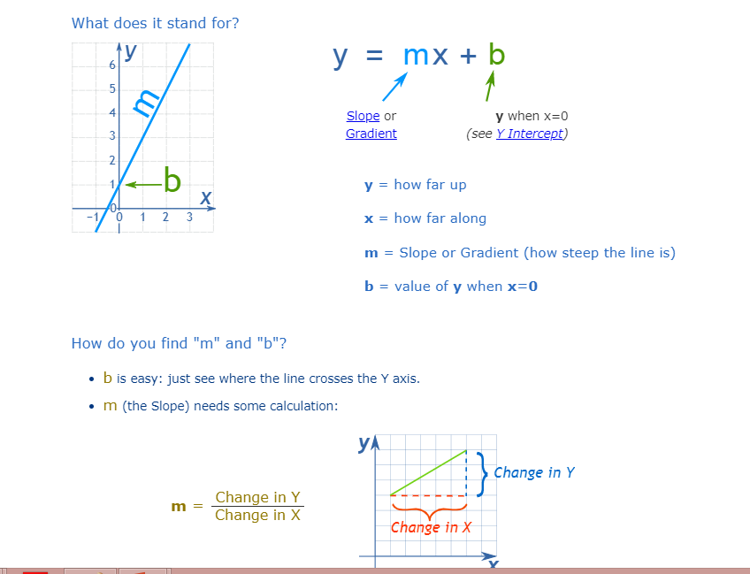

Slide 7
The two endpoints of a line segment are specified at positions (x1,y1) and (x2,y2).
y
P2(x2,y2)
P1(x1,y1)
b
0
x

Slide 8
We can determine the value for slope m & b intercept as
m = y2-y1/x2-x1
i.e. m= Δy/ Δx (2)

Slide 9
Example 1 The endpoints of line are(0,0) & (6,18). Compute each value of y as x steps from 0 to 6 and plot the result.
Solution : Equation of line is y= mx +b
m = y2-y1/x2-x1= 18-0/6-0 = 3
Next the y intercept b is found by plugging y1& x1 into the equation y = 3x + b,
0 = 3(0) + b. Therefore, b=0, so the equation for the line is y= 3x.

Slide 10
U need to tell the co-ordinates of Line using these Line function???

Slide 11
The challenge is to find a way to calculate the next x,y position by previous one as quickly as possible.

Slide 12
DDA Algorithm

Slide 13
DDA Algorithm
The Digital differential analyzer (DDA) algorithm is an incremental scan-conversion method.
Such an approach is characterized by performing calculations at each step using results from the preceding step.

Slide 14
DDA Algorithm-
DDA Algorithm is the simplest line drawing algorithm.

Slide 15
Given the starting and ending coordinates of a line,
DDA Algorithm attempts to generate the points between the starting and ending coordinates.

Slide 16
Procedure-
Given-
Starting coordinates = (X0, Y0)
Ending coordinates = (Xn, Yn)
The points generation using DDA Algorithm involves the following steps-

Slide 17
Step-01:
Calculate ΔX, ΔY and M from the given input.
These parameters are calculated as-
ΔX = Xn – X0
ΔY =Yn – Y0
M = ΔY / ΔX

Slide 18
Step-02:
Find the number of steps or points in between the starting and ending coordinates.
if (absolute (ΔX) > absolute (ΔY))
Steps = absolute (ΔX);
else
Steps = absolute (ΔY);

Slide 19
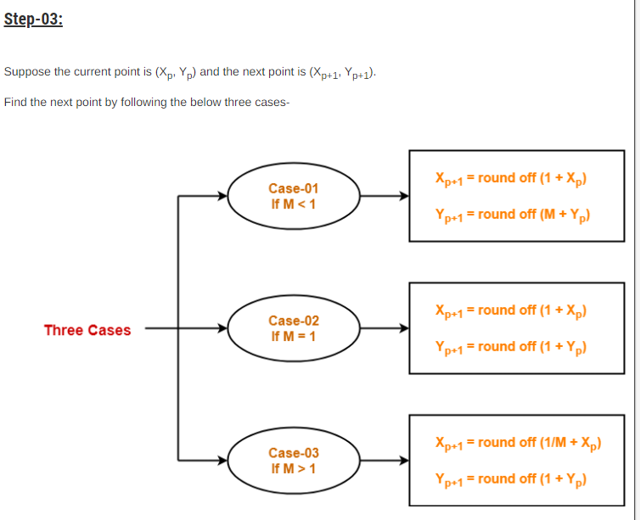

Slide 20
Step-04:
Keep repeating Step-03 until the end point is reached or the number of generated new points (including the starting and ending points) equals to the steps count.

Slide 21
Practice problems

Slide 22
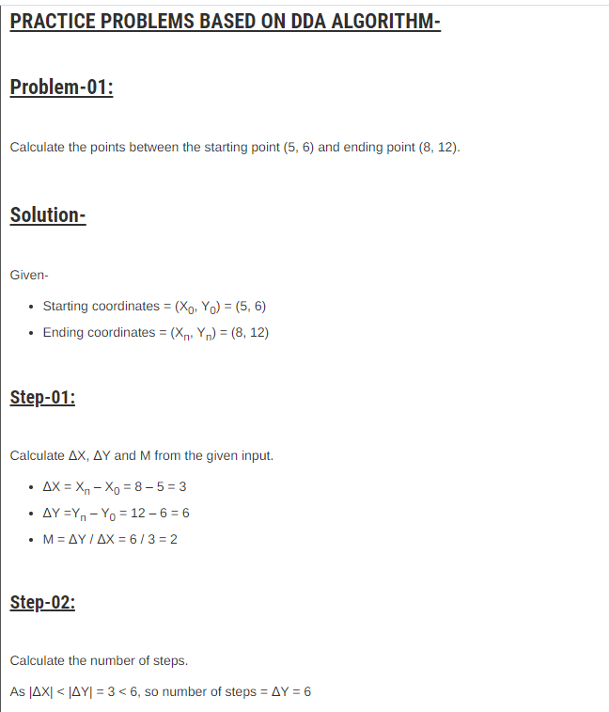

Slide 23
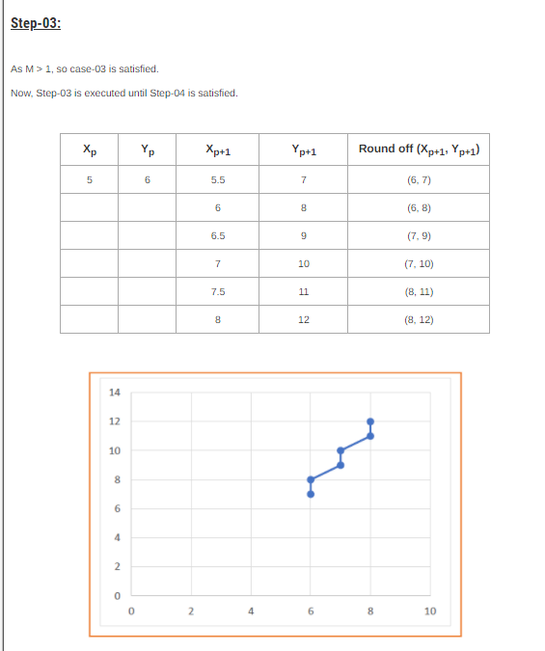

Slide 24
Try urself??

Slide 25
Problem-02:
Calculate the points between the starting point (5, 6) and ending point (13, 10).

Slide 26
Problem-03:
Calculate the points between the starting point (1, 7) and ending point (11, 17).

